Slide 1
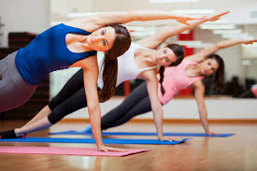
Survey Results of the Exercise Habits of College Students
By Lizzy Grewach

Slide 2

Why I did this?
23 University of Minnesota students were polled.
To learn about the exercise habits of my peers.
I like to workout but wondered where I fall in my exercise habits in respect to others my age.
I also was interested in the types and styles of exercise people do.

Slide 3
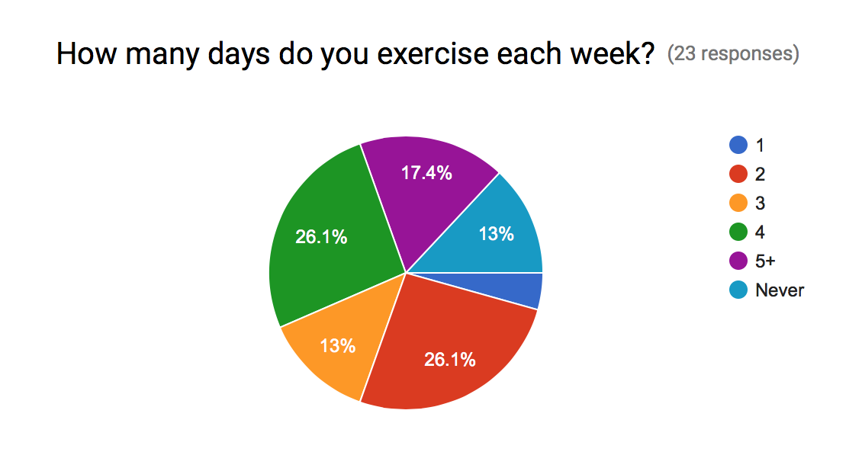
“How often do you exercise each week?”
The majority of those polled workout 2 or 4 days per week. (26.1% each)
Only 1 person works out 1 day per week.

Slide 4
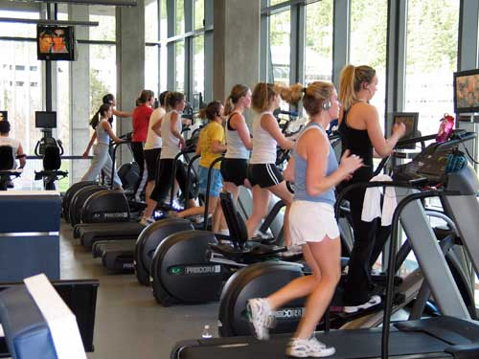
“Where do you exercise?”
The large majority either exercise at the University Rec Center. (72.7%)
Followed by those who exercise outside. (59.1%)
The place people work out at the least is their apartment/home gym. (9.1%)

Slide 5
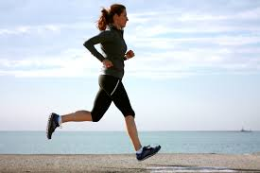
“What type of exercise do you do primarily?”
Over half of those polled said that they do running or cardio when they workout.
Some of the less popular responses were Tennis, Zumba, and Walking. These are popular activities but each only had one participant in this survey.

Slide 6

“At what time of day and for how long do you exercise for?”
Almost half of those surveyed said that they workout in the afternoon (47.6%).
The least popular time to workout is at night.
18 of 23 people said that they workout for about an hour when exercise.

Slide 7

“What’s your age group?”
Of the 23 people surveyed:
60% were ages 18-20
40% were ages 21-25

